Slide 1

Group & Team Theory
Session IV

Slide 2

Chapter outlines
13. Power in Teams and Groups
14. Leadership

Slide 3
Learning Objectives
Explain different conceptualizations of power
Discuss behaviors associated with high status in a group
Differentiate between the common power bases in groups
What is the nature of leadership and the leadership process
How do leaders influence and move their followers to action?
What are the trait perspectives on leadership?
How do different approaches and styles of leadership impact what is needed now?

Slide 4
13. Power in Teams and Groups

Slide 5
Defining Power
“Power lives in relationships, not in people”
Power-over
Power-from-within
Power-with

Slide 6
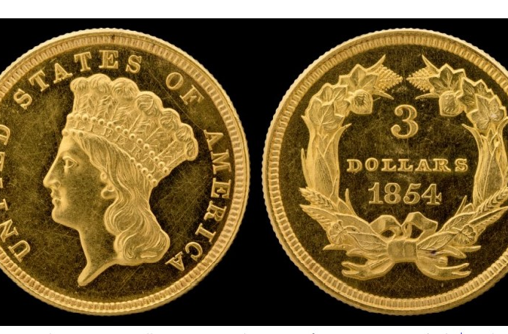
UNDERSTANDING POWER AND OPPRESSION
Power and oppression can be said to be mirror reflections of one another in a sense or two sides of the same coin.

Slide 7
RELATIONSHIP BETWEEN Power and Status
Status
Power
Can be defined as a person’s perceived level of importance or significance within a particular context.
Members with higher status are apt to command greater respect and possess more prestige and power than those with lower status.

Slide 8
Bases of Power in GROUPS
Referent Power
Legitimate Power
Reward Power
Coercive Power

Slide 9
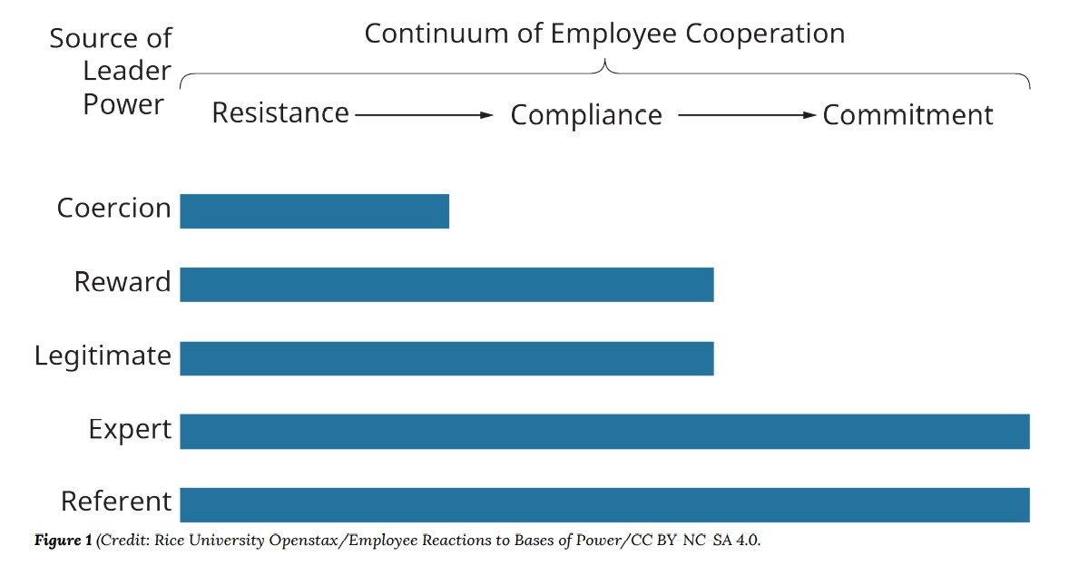
Consequences of Power

Slide 10

Power Dependencies
In any situation involving power, at least two persons (or groups) can be identified:
(1) the person attempting to influence others and
(2) the target or targets of that influence.
All people are not subject to (or dependent upon) the same bases of power

Slide 11
What causes some people to be vulnerable to power attempts?
Subordinate’s Values
Person B’s values can influence his susceptibility to influence.
If an employee places a high value on money and believes the supervisor actually controls pay raises, we would expect the employee to be highly susceptible to the supervisor’s influence.

Slide 12
What causes some people to be vulnerable to power attempts?
2. Nature of Relationship
The nature of the relationship between A and B can be a factor in power dependence.
Are A and B peers or superior and subordinate?
Is the job permanent or temporary?
A person on a temporary job, for example, may feel less need to acquiesce, because he won’t be holding the position for long.

Slide 13

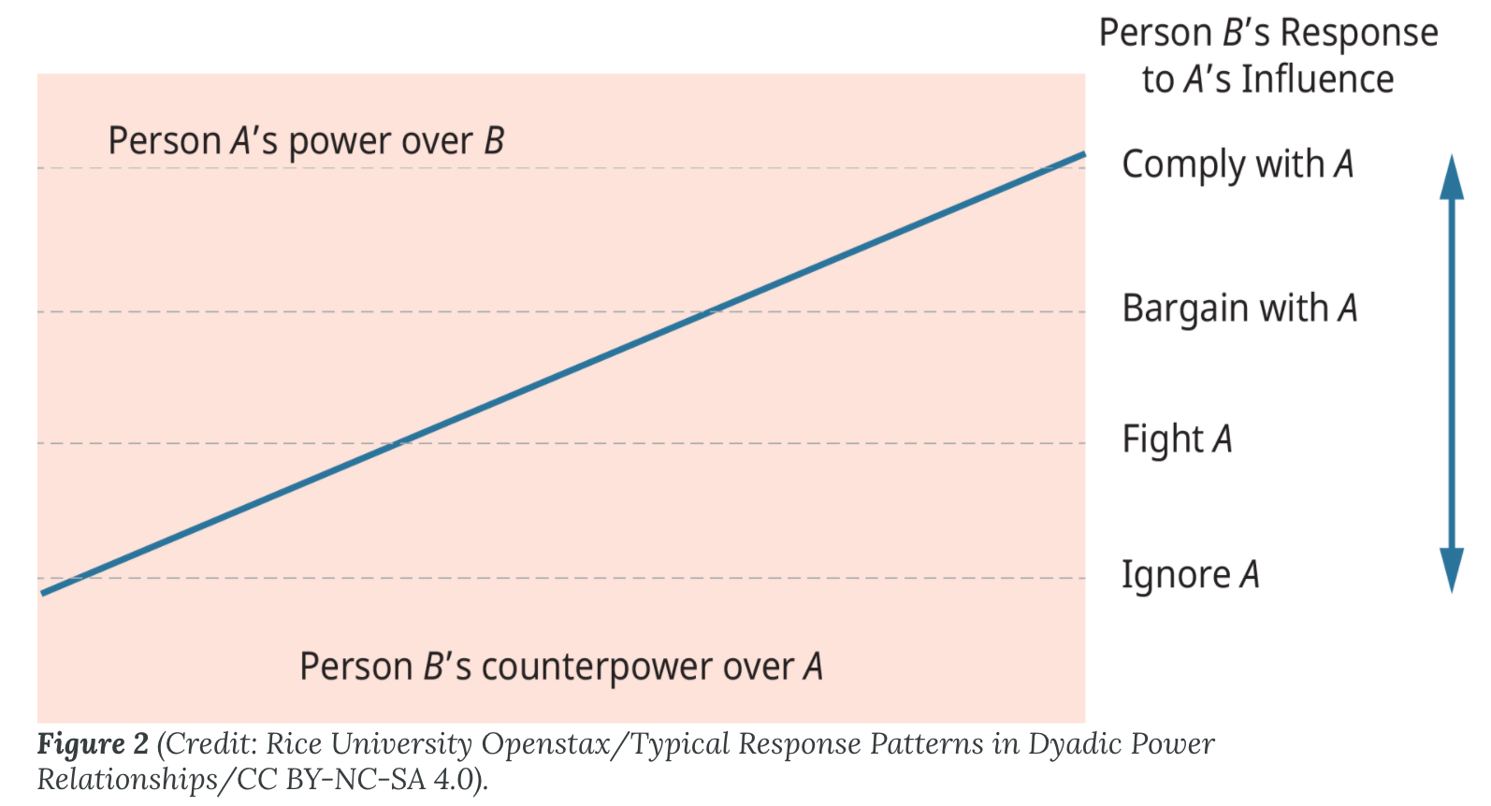
What causes some people to be vulnerable to power attempts?
3. Counterpower
B has other sources of power to buffer the effects of A’s power. For example, if B is unionized, the union’s power may serve to negate A’s influence attempts

Slide 14
Uses of Power
Common Power Tactics in Organizations
Controlling Access to Information
Controlling Access to Information
Selective Use of Objective Criteria
Selective Use of Objective Criteria
Using Outside Experts
Using Outside Experts
Coalitions and Alliances

Slide 15
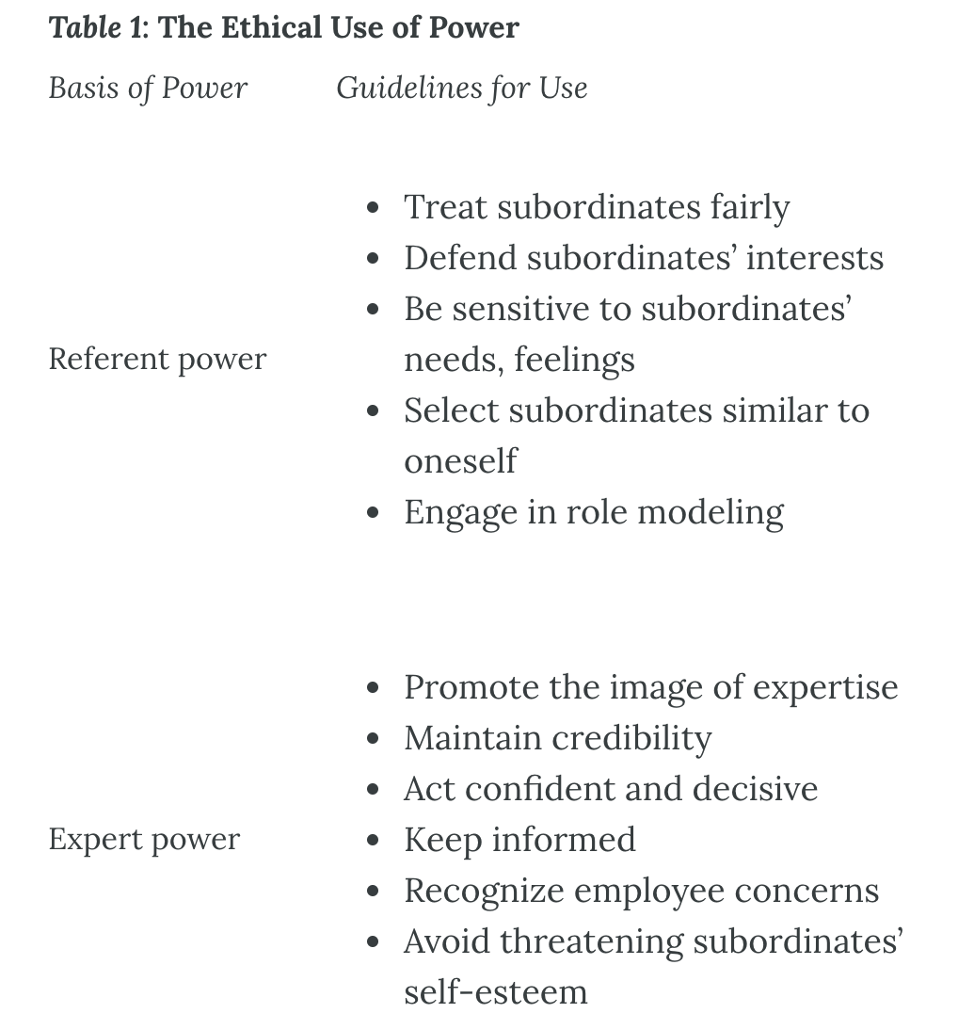
Ethical Use of Power

Slide 16
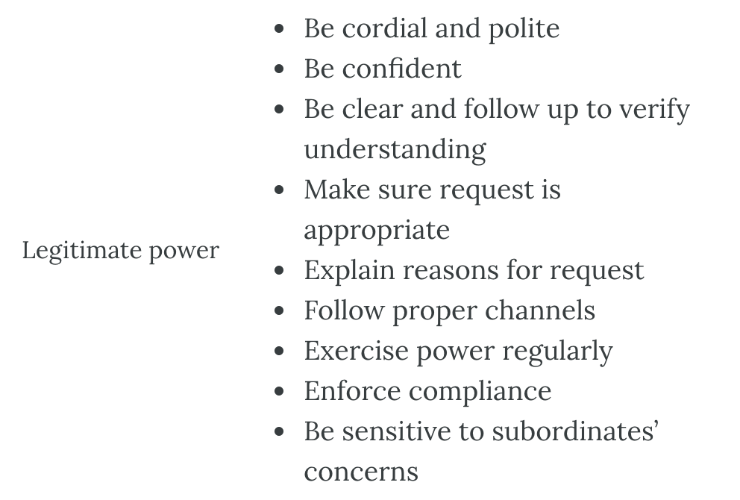
Ethical Use of Power

Slide 17
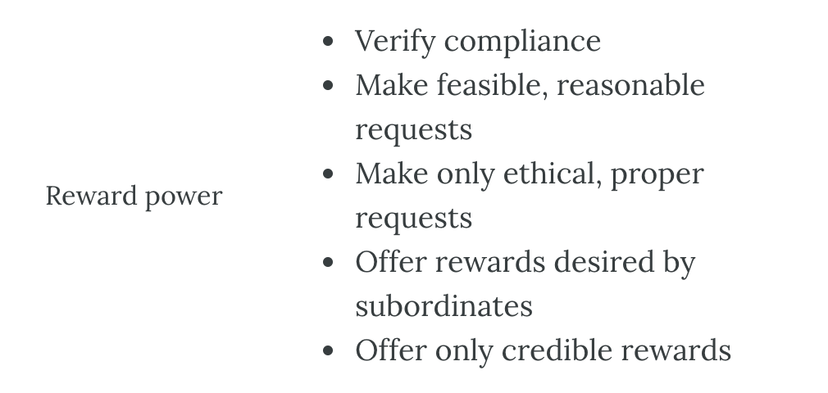
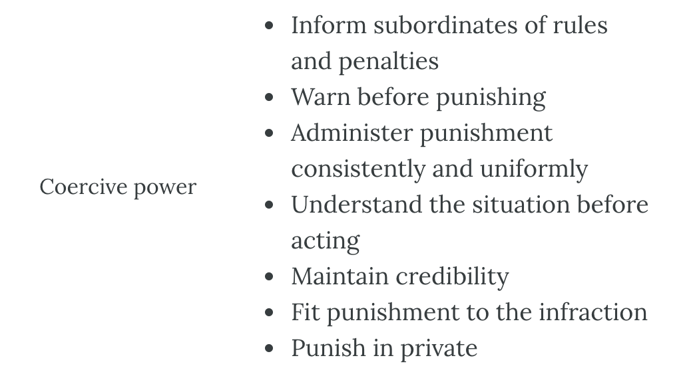
Ethical Use of Power

Slide 18
Reflection Question
When you first joined your group, what assumptions did you make about the status of different members? Where did those assumptions come from?

Slide 19
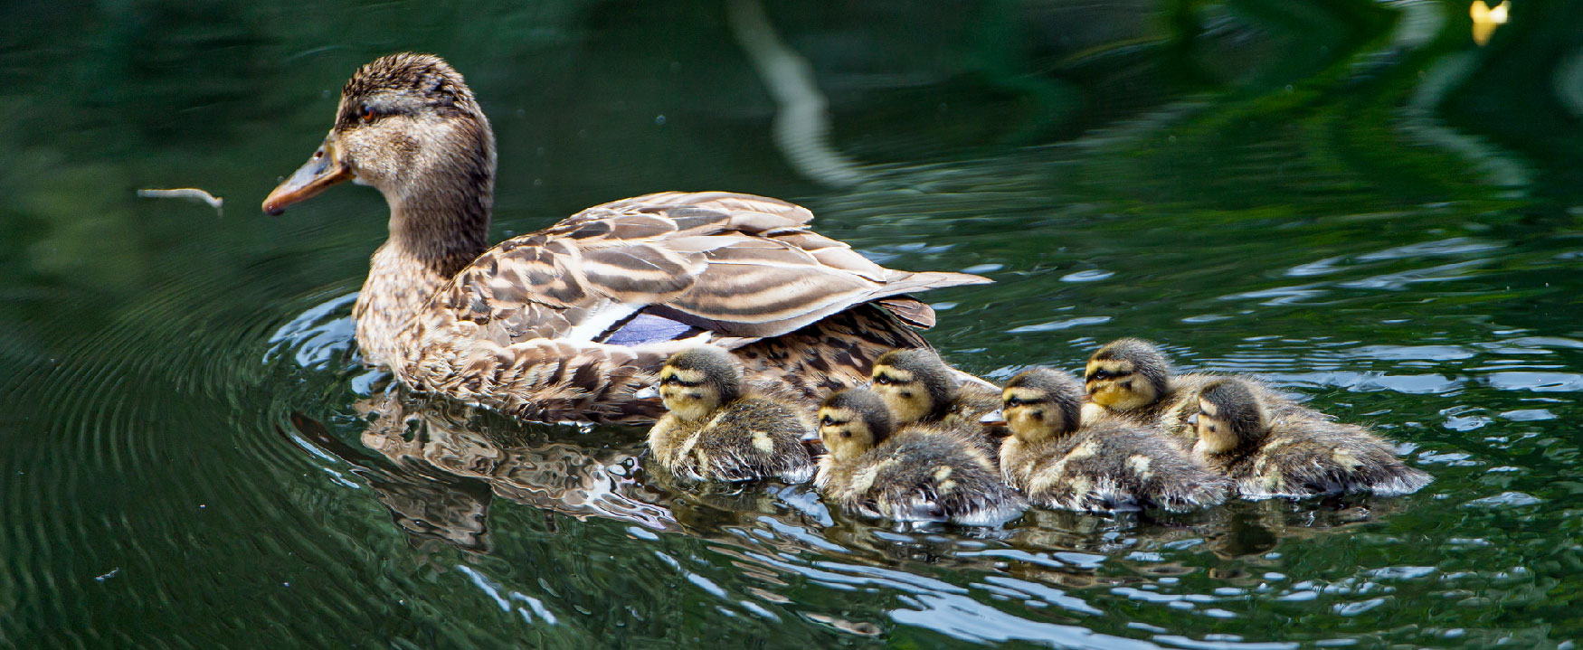
14. Leadership

Slide 20

The Nature of Leadership
1. What is the nature of leadership and the leadership process?

Slide 21
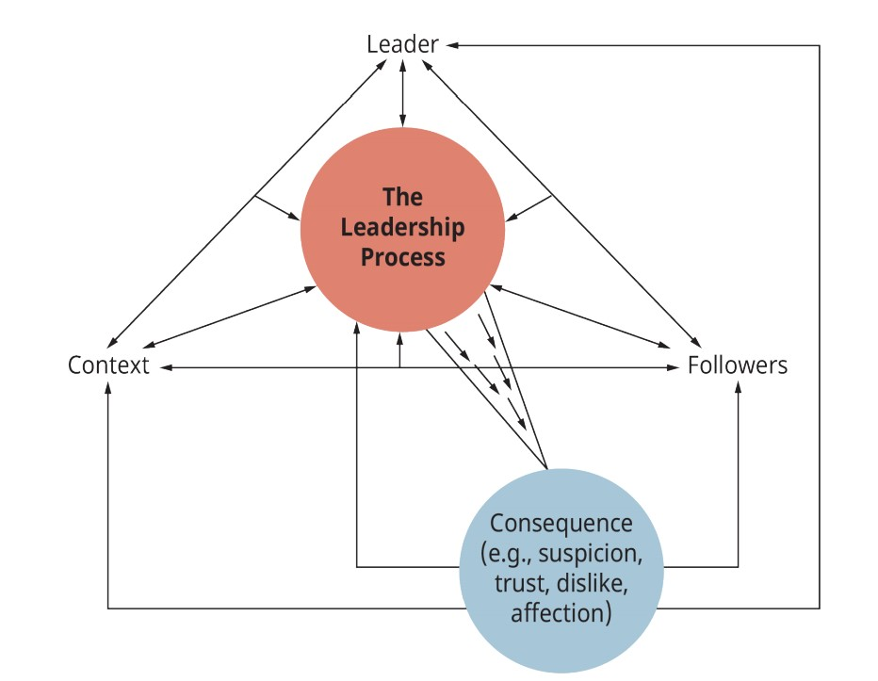

Slide 22
The Leader
The Context
refers to the situation
that surrounds the leader and the followers.
The Process
is a complex, interactive, and dynamic working relationship between leader and followers.
The Consequences
two outcomes are important:
1. shared set of norms and values, and have they developed a good working relationship?
2. Have the group’s task needs been met?

Slide 23
Leader Emergence and Designated leader
Formal leader
Informal leader
Is that individual who is recognized by Leadership | 265 those outside the group as the official leader of the group
Is that individual whom members of the group acknowledge as their leader

Slide 24
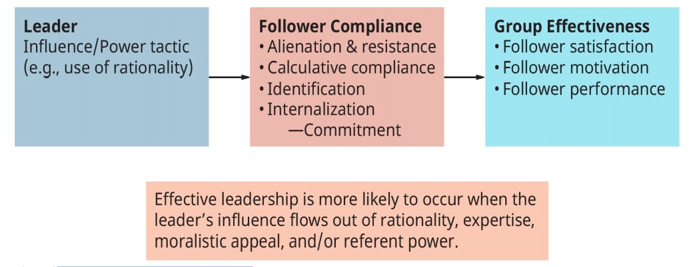
The Leader-Follower Power Relationship

Slide 25

Discussion: Leadership Needs in the 21st Century
1. How do different approaches and styles of leadership impact what is needed now?

Slide 26
Homework: Read and write a reflect essay on one of the following topics:
The Trait Approach to Leadership: What are the trait perspectives on leadership?
Behavioral Approaches to Leadership: What are the behavioral perspectives on leadership?
Situational (Contingency) Approaches to Leadership: Situational (Contingency) Approaches to Leadership: What are the situational perspectives on leadership?
Substitutes for and Neutralizers of Leadership: What does the concept of “substitute for leadership” mean?
Transformational, Visionary, and Charismatic Leadership: What are the characteristics of transactional, transformational, and charismatic leadership?
Notes:
Lecturers should take activity points

Slide 27
